Slide 1
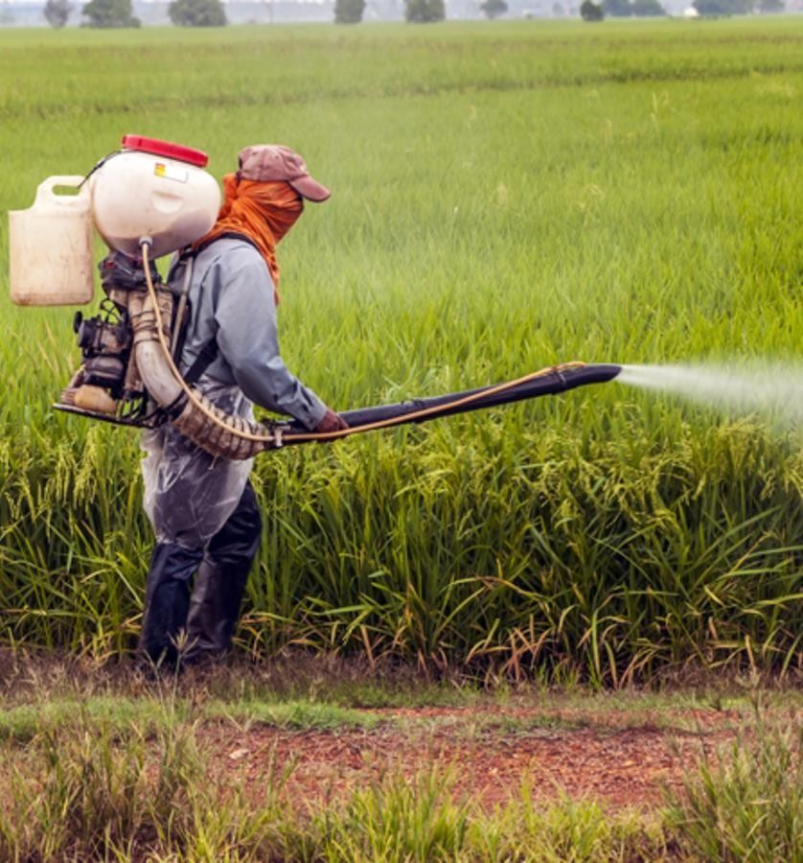


Interim Update - Market and Business Environment Report—
Prepared for:
December 02, 2022
Prepared By:
www.chemanalyst.com

Slide 2
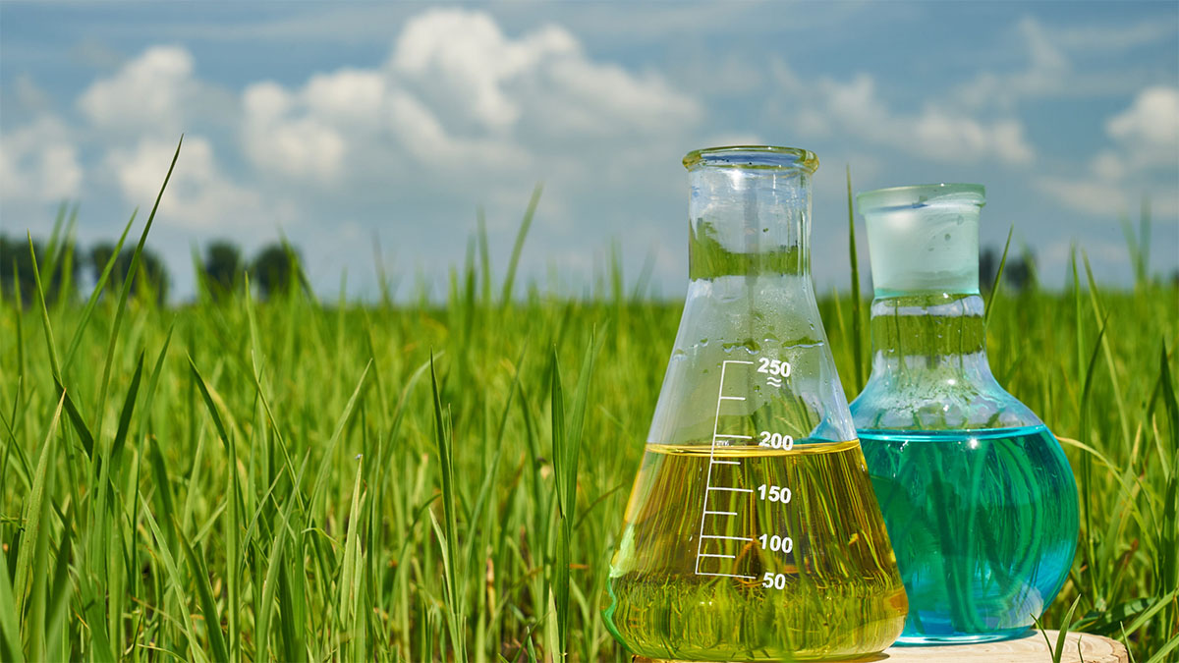
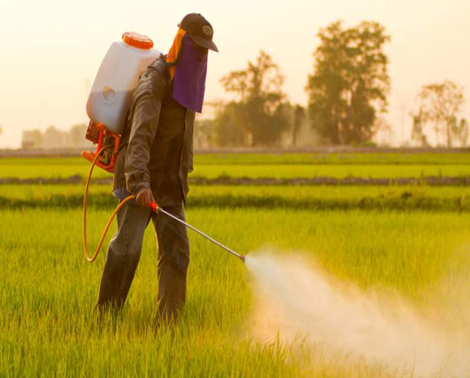
Product Overview- Agrochemicals
Agrochemicals are pesticides, herbicides, or fertilizers used for the management of ecosystems in agricultural sectors. Rudimentary variations on agrochemicals have been used for millennia to improve crop yields and control the populations of agricultural pests.
The earliest known use of agrochemicals dates to roughly 2500 B.C. when Sumerian farmers relied on Sulphur (S) compounds to reduce insect populations and the subsequent risk of pest-related famine.
Types of Agrochemicals-
There is a concerted effort to actively and conscientiously implement a broad range of agrochemicals to safely maintain and control the global food supply to ensure consistently high quality for widespread consumption. Types of agrochemicals include:
Pesticides, or chemicals engineered to destroy insects and other organisms, weeds, and funguses that could spoil crop yields;
Synthetic fertilizers, for example ammonium nitrate (NH4NO3), which is designed to encourage crop growth by saturating soils with nutrients;
Acidifiers and liming agents, engineered to alter the pH levels of soils to suit the planting properties of given crops;
Soil conditioners, for example gypsum (CaSO4·2H2O), which is designed to condition soils with high sodium (Na) contents to improve planting conditions;
Growth hormones, or synthetic chemicals designed to increase growth rates in animals and crops.

Slide 3
Global Agrochemicals Market, By Value & Volume
Figure 1: Global Agrochemicals Market Size, By Value (USD Billion) & By Volume (in MMT), 2017, 2021, 2025F, 2030F, 2035F, 2040F
CAGR 2017-2021
By Value: 2.9%
CAGR 2021-2030F
By Value: 4.5%
CAGR 2030-2040F
By Value: 3.4%
CAGR 2017-2021
By Volume: 2.3%
CAGR 2021-2030F
By Volume: 3.9%
CAGR 2030-2040F
By Volume: 3.0%
Global Agrochemicals market stood at USD 220 billion and is expected to reach USD 324 billion at a CAGR of 4.5% by 2030 and 454 billion by the end of 2040 at a CAGR of 3.4%.
Covid did not affected the agrochemicals market owing to increase in demand of consumables in that period.
Initiatives such as “Make in India” and the PLI Scheme improve the manufacturing sector dynamics of India, and hence more industries are established.
Source: ChemAnalyst

Slide 4
Global Agrochemicals Market, By Value
Figure 2: Global Agrochemicals Market, By Type, By Value (USD Billion), 2017, 2021, 2025F, 2030F, 2035F, 2040F
Total in USD Billion
197
220
256
324
390
454
Others: Biopesticides, etc.
Insecticides is India's most demanded Agrochemicals, having a market share of more than 50%, and it stood at USD 117.8 billion in FY2021.
In the forecast period, it is expected that insecticides will dominate the agrochemicals with a market share of over 50%.
Source: ChemAnalyst

Slide 5
Global Agrochemicals Market, By Volume
Figure 2: Global Agrochemicals Market, By Type, By Volume (MMT), 2017, 2021, 2025F, 2030F, 2035F, 2040F
Total in MMT
171
187
213
263
309
355
Others: Biopesticides, etc.
Source: ChemAnalyst

Slide 6
India Agrochemicals Market, By Value & Volume
Figure 3: India Agrochemicals Market Size, By Value (USD Billion) & By Volume (in MMT), 2017, 2021, 2025F, 2030F, 2035F, 2040F
CAGR 2017-2021
By Value: 8.3%
CAGR 2021-2030F
By Value: 10.4%
CAGR 2030-2040F
By Value: 8.4%
CAGR 2017-2021
By Volume: 8.0%
CAGR 2021-2030F
By Volume: 9.8%
CAGR 2030-2040F
By Volume: 8.1%
India Agrochemicals market stood at USD 6.3 billion and is expected to reach USD 15.2 billion at a CAGR of 10.4% by 2030 and 34.7 billion by the end of 2040 at a CAGR of 8.4%.
India is the fourth-largest producer of agrochemicals in the world after USA, Japan and China.
The major dynamics to the agrochemicals market includes, decreasing arable land, declining soil fertility, heavy dependency on monsoon for irrigation and many more.
Source: ChemAnalyst

Slide 7
India Agrochemicals Market, By Value
Figure 4: India Agrochemicals Market, By Type, By Value (USD Billion), 2017, 2021, 2025F, 2030F, 2035F, 2040F
Total in USD Billion
5
6
9
15
24
35
Others: Biopesticides, etc.
Source: ChemAnalyst

Slide 8
India Agrochemicals Market, By Volume
Figure 4: India Agrochemicals Market, By Type, By Volume (MMT), 2017, 2021, 2025F, 2030F, 2035F, 2040F
Total in MMT
3
4
6
10
15
21
Others:
Source: ChemAnalyst

Slide 9
Product Overview- Micronutrients
Micronutrients are essential plant nutrients that are found in trace amounts in tissue but play an imperative role in plant growth and development. Without these nutrients, plant nutrition would be compromised leading to potential declines in plant productivity. Of the 17 elements essential for plant growth, eight are micronutrients: boron (B), chlorine (CI), copper (Cu), iron (Fe), manganese (Mn), molybdenum (Mo), zinc (Zn) and nickel (Ni).
Mineral elements nurture horticultural crops and also crops of cereals, pulses, oilseeds, spices, and plantation. In spite of the low demand, critical plant functions are hindered if micronutrients are unavailable, which results in plant deformations, lower yield, and diminished growth. Micronutrients are crucial for plant growth and play an important role in balancing crop nutrition.
There is increasing interest from the agricultural community in micronutrient fertilization for a variety of reasons including:
soil erosion and long-term cropping have resulted in the removal of micronutrients from soils;
increasing crop yields generally leads to greater micronutrient removal rates in grain and other harvested products; and
the widespread replacement of micronutrient-rich manures with mineral fertilizers has reduced micronutrient addition from fertilizer sources. Collectively, these factors have led farmers to question whether micronutrient fertilization may now be required to meet the changing demands of crop nutrition.

Slide 10
Global Micronutrients Market, By Value & Volume
Figure 1: Global Micronutrients Market Size, By Value (USD Billion) & By Volume (in KT), 2017, 2019, 2021, 2025F, 2027F
CAGR 2017-2021
By Value: 6.8%
CAGR 2022-2027F
By Value: 8.3%
CAGR 2017-2021
By Volume: 6.1%
CAGR 2022-2027F
By Volume: 7.6%
Global Micronutrients market stood at USD 3.6 billion and is expected to reach USD 6.5 billion at a CAGR of 8.3% by 2027
This is attributable to the deteriorating soil quality in cultivated lands. Micronutrients for crops are essential for plant growth and metabolic processes.
The market for crop micronutrients is expanding as a result of factors like rising public awareness of the advantages of crop micronutrients for crop productivity and yields.
Source: ChemAnalyst

Slide 11
India Micronutrients Market, By Value & Volume
Figure 1: India Micronutrients Market Size, By Value (USD Billion) & By Volume (in KT), 2017, 2019, 2021, 2025F, 2027F
CAGR 2017-2021
By Value: 8.8%
CAGR 2022-2027F
By Value: 9.2%
CAGR 2017-2021
By Volume: 8.3%
CAGR 2022-2027F
By Volume: 8.8%
India Micronutrients market stood at USD 0.6 billion and is expected to reach USD 1.1 billion at a CAGR of 9.2% by 2027.
Micronutrients are essential for a balanced diet and a great tool for farmers to improve crop quality and yield.
The market value for agricultural micronutrients has increased as a result of the expanding trend of biofortification in mungbean, wheat, maize, potatoes, and sweet potatoes.
Source: ChemAnalyst

Slide 12


ChemAnalyst– North America
708 Third Avenue, Manhattan,
New York, United States
Tel: +1- 646- 360- 1656
Email: sales@ChemAnalyst.com www.ChemAnalyst.com
ChemAnalyst – Europe
54, Oldbrook, Bretton,
Peterborough,
United Kingdom
Email: Email: sales@ChemAnalyst.com www.ChemAnalyst.com
ChemAnalyst – Asia-Pacific
B – 44, Sector – 57, Noida, National Capital Region, U.P. - India
Tel: +91-120-4523900
Email: Email: sales@ChemAnalyst.com www.ChemAnalyst.com
Thank you!!
We look forward to serving your research needs!!
12

